Slide 1


Green Pace
Security Policy Presentation
Developer: Isaac Trudeau
Notes:
Hello ​everyone. My name is​ Isaac Trudeau ​and today I will be presenting the Green​ ​Pace Security Policy​, which is designed to standardize and improve our security practices across the development team. It is important that we align our principles with industry best practices and integrate security throughout the software development lifecycle.

Slide 2

OVERVIEW: DEFENSE IN DEPTH
Various levels of security for network, application, and data by following coding and encryption standards.
Mitigating vulnerabilities
Best practices
LAYERS
Notes:
Our security policy is built around the concept of ​Defense in Depth, a strategy​ that implements ​multiple layers of security controls throughout​ the development process. This approach ensures that even if one layer is compromised, the other layers continue to protect our systems and data. ​For example, at the network level​, we might employ ​intrusion detection systems or firewalls. ​We enforce coding standards and conduct security testing at the application level. Finally, ​at the data level​, we use access​​ controls and encryption to safeguard sensitive information. By layering these security measures, we significantly reduce the risk of attack and mitigate the risks associated with potential vulnerabilities.

Slide 3
THREATS MATRIX
Likely – Occur more often and are likely to show up.
Unlikely – Occur less often and are not as common.
Priority – Require immediate attention to mitigate security risk
Low Priority – Require attention but do not pose as much of a security risk.
 | Likely | Unlikely
Priority | STD-003-CPP: Input Validation STD-007-CPP: Handle Exceptions STD-004-CPP: Avoid SQL Injection STD-005-CPP: Free Up Memory | STD-001-CPP: Data type
Low Priority | STD-002-CPP: Use of Constants STD-008-CPP: Naming Conventions STD-009-CPP: Declarations STD-010-CPP: Floating Point Comparisons | STD-006-CPP: Assertions
Notes:
In this Threats Matrix, I’ve categorized various vulnerabilities based on their likelihood of occurrence and the priority they should be given in our development process. High-priority vulnerabilities, such as input validation issues and exception handling errors are more likely to occur and can have severe consequences if not addressed promptly. On the other hand, vulnerabilities like the use of constants or handling floating point comparisons, while important, pose a lower risk and can be addressed with less urgency. This matrix helps us prioritize our efforts, ensuring that we focus on the most critical issues first while still maintaining overall security.

Slide 4
10 PRINCIPLES
Validate Input Data
Heed Compiler Warnings
Architect and Design for Security Policies
Keep It Simple
Default Deny
Adhere to the Principle of Least Privilege
Sanitize Data Sent to Other Systems
Practice Defense in Depth
Use Effective Quality Assurance Techniques
Adopt a Secure Coding Standard
Notes:
Here we have ​the ten core principles that guide our security policy​. Each principle is aligned ​with specific coding standards​ to ensure that our development ​practices are​ secure by design. For instance, the principle of validating input data is crucial for ​preventing common attacks​ like ​SQL injection​. Heeding compiler warnings ensures that potential issues are flagged early while the principle of least privilege helps minimize the risk by limiting access rights for users and processes to the bare minimum necessary. By adhering to these principles, we create a strong foundation for secure software development

Slide 5
CODING STANDARDS
STD-001-CPP: Data Type Consistency
STD-002-CPP: Use of Constants
STD-003-CPP: Input Validation
STD-004-CPP: Avoid SQL Injection
STD-005-CPP: Free Up Memory
STD-006-CPP: Remove Assertions
STD-007-CPP: Handle Exceptions
STD-008-CPP: Naming Conventions
STD-009-CPP: Separate Variable Declarations
STD-010-CPP: Handle Floating Point Comparisons
Notes:
Our coding standards are designed to address common security vulnerabilities and ensure that our code is both secure and maintainable.
Data Type Consistency ensures that data types are used correctly to prevent errors like buffer overflows and type mismatches.
Use of Constants is encouraged instead of hard-coded values, which improves code readability and maintainability.
Input Validation verifies that ​all input​ data ​is validated to prevent injection attacks​ and other security issues caused by untrusted input.
Avoid SQL Injection implements practices such as ​parameterized queries to prevent​ SQL injection vulnerabilities.
Free Up Memory ​ensures that dynamically allocated memory is properly​ managed and ​freed to prevent memory leaks which can​ lead to program failure.
Remove Assertions requires the removal of debugging assertions from production code to avoid unnecessary exposure of internal logic.
Handle Exceptions implements proper exception handling to ensure that errors are managed safely and do not lead to crashes or undefined behavior.
Naming Conventions creates clear and consistent naming conventions for variables, functions, and classes to improve code clarity.
Separate Variable Declarations encourages declaring each variable on a separate line to improve code readability and reduce the risk of errors.
Handle Floating Point Comparisons ensures that floating-point numbers are compared using appropriate methods to avoid precision errors.

Slide 6
ENCRYPTION POLICIES
Encryption at rest | Policy: All stored data shall be encrypted. What: Encryption at rest is the protection of data that is stored Applied: Any time data is stored in a database, hard drive, CD, etc. The data should be encrypted Why use: This policy should be used to help prevent data retrieval in the event of a breach.
Encryption in flight | Policy: All data being transferred shall be encrypted What: Encryption in flight is the protection of data moving in a network Applied: Any time data is being transferred from one location to another it needs to be protected by encryption Why use: This policy should be used to prevent data retrieval in the event of interception of transfers.
Encryption in use | Policy: All data shall be encrypted while being processed by an application. What: Encryption in use is the protection of data being used or processed by an application. Applied: Any time data is being used by an application it should be protected by encryption Why use: The use of this policy will protect the data being used by an application.
Notes:
​​The use of encryption is an important part of our security strategy​ and we have established clear policies for encrypting data ​at rest, in flight, and in use​. For data at rest, such as information ​stored in​ databases or on hard drives, we use strong encryption algorithms to prevent unauthorized access. Data in flight, moving across networks, is protected by Transport Layer Security to ensure that it cannot be intercepted and read. Finally, data in use remains encrypted to protect it from exposure in memory or during processing. These encryption policies are essential for protecting sensitive information at every stage of its lifecycle.

Slide 7
TRIPLE-A POLICIES
Authentication | Policy: Authentication must be used to validate user identity What: Verification of user data typically for user login to identify the user Applied: Usernames and passwords validated by database record Why Use: This can be used to only let trusted or known users access the system
Authorization | Policy: Authorize users to only what they need What: Permission granted to users that allow different levels of access to the system Applied: Roles are applied to user accounts and defined in the code Why Use: Restricts access to only those who need it to prevent unauthorized access and mitigate risk
Accounting | Policy: Track user activity in the system with date, time, and actions What: User activity is tracked to identify risk and determine Applied: User activity logs are stored for analysis and flagged when activity is unusual Why Use: Gain insights into user activity to help prevent or track security issues
Notes:
​​The Triple-A-Policies of Authentication, Authorization, and Accounting​ are an important part of our security policy​​. Authentication verifies the identity of users, typically through credentials like usernames and passwords, or more secure methods like multi-factor authentication. ​Authorization ensures that users can only access the resources​ they absolutely need following the principle of least privilege. Finally, accounting involves tracking user activities within the system, logging actions like logins, data access, and modifications. This logging is critical for auditing and helping us detect and respond to suspicious behavior.

Slide 8
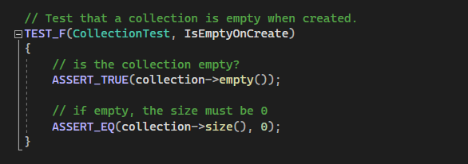
Unit Testing Collection is empty
Notes:
Slide 8: Collection is Empty: This test verifies that a newly created collection is empty, ensuring no unintended data is present at initialization.

Slide 9
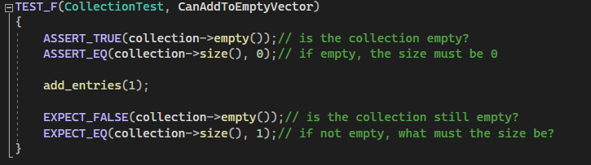
Unit Testing Adding to empty Vector
Notes:
Slide 9: Adding to Empty Vector: Here, we test adding ​a single element to​ an empty vector, checking that the size updates correctly and that the element is added without errors.

Slide 10
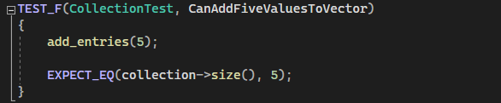
Unit Testing Add Five Values
Notes:
Slide 10: Add Five Values: This test ensures that the vector correctly handles multiple additions, updating the size and storing the values as expected.

Slide 11
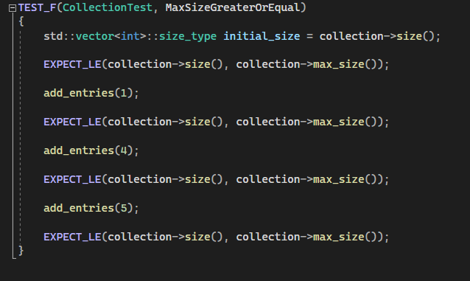
Unit Testing Max Size Greater or Equal
Notes:
Slide 11: Max Size Greater or Equal: We check that the vector’s size does not exceed its maximum allowable size, preventing overflow errors.

Slide 12
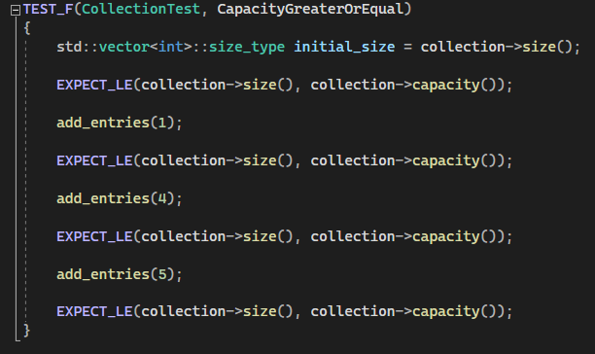
Unit Testing Capacity Greater or Equal
Notes:
Slide 12: Capacity Greater or Equal: This test ensures ​that the vector’s capacity is​ ​always greater than or equal to its size​, verifying proper memory allocation

Slide 13
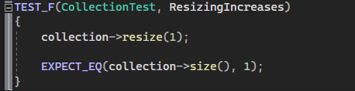
Unit Testing Resizing Increases
Notes:
Slide 13: Resizing Increases: We verify that resizing the vector increases its capacity and maintains data integrity

Slide 14
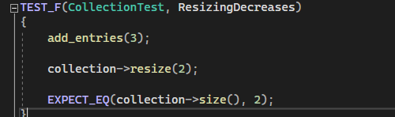
Unit Testing Resizing Decreases
Notes:
Slide 14: Resizing Decreases: This test ensures that when the vector is resized to a smaller size, excess elements are removed correctly.

Slide 15
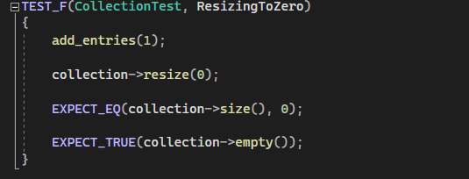
Unit Testing Resizing to zero
Notes:
Slide 15: Resizing to Zero: Here, we check that resizing the vector to zero clears all elements, leaving an empty vector.

Slide 16
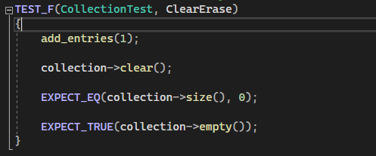
Unit Testing Clear Erase
Notes:
Slide 16: Clear Erase: This test confirms that calling clear() on the vector removes all elements and resets the size to zero.

Slide 17
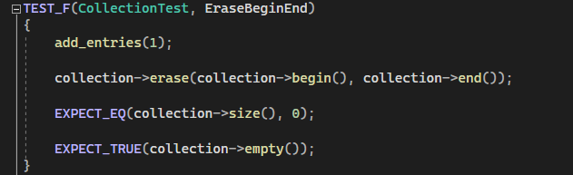
Unit Testing Erase Begin End
Notes:
Slide 17: Erase Begin End: We verify that erasing a range of elements correctly reduces the size and maintains data integrity.

Slide 18
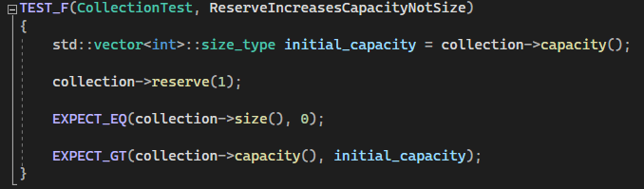
Unit Testing Reserve Increases Capacity Not Size
Notes:
Slide 18: Reserve Increases Capacity Not Size: This test checks that reserving capacity increases the vector’s storage space without affecting the current size.

Slide 19

AUTOMATION SUMMARY
Notes:
Automation plays a vital role in our security strategy by integrating security checks into our DevSecOps pipeline. By automating these processes we ensure that security is consistently applied throughout the development lifecycle. CppCheck and SonarQube are integrated into our pipeline to perform static code analysis, identifying potential vulnerabilities in our code before it’s even compiled. OWASP ZAP is used to perform dynamic security testing on web applications simulating attacks and identifying weaknesses. These tools allow us to detect and address vulnerabilities early, reducing the risk of security issues making it into production.

Slide 20
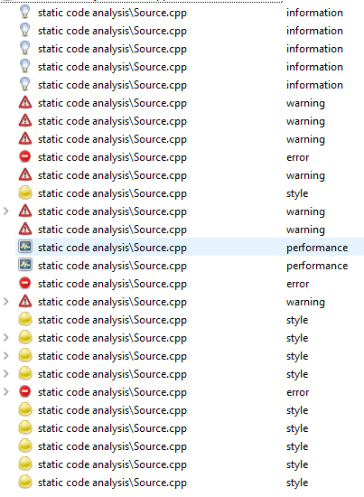
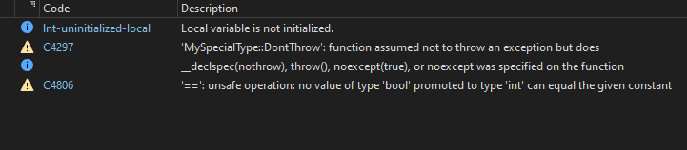
TOOLS
From the same code
Cpp Check Error reporting
Visual Studio Error reporting
Cpp Check – Static Analysis security tool
SonarQube - Static Analysis security tool
OWASP Zap – Web based application security tool
Valgrind – Memory management security tool
Notes:
We use a variety of external tools to enforce our security policies and detect vulnerabilities across different stages of development. CppCheck and SonarQube are used for static code analysis, catching issues like coding errors and security flaws at an early stage. OWASP ZAP is a powerful tool for testing our web applications against known vulnerabilities, while Valgrind helps us identify memory management issues that could lead to security risks.

Slide 21
RISKS AND BENEFITS
Risks of delaying security implementation
Less effective security measures
Higher remediation costs
Missed opportunities
Higher chance of flaws
Benefits of implementing security throughout
Improved quality and security
Overall faster development
Cost effective
Reduce risk
Notes:
There are significant risks associated with delaying the implementation of our security policies. Waiting until later stages to address security can result in less effective measures, higher remediation costs, and missed opportunities to catch vulnerabilities early. Additionally, the likelihood of flaws going undetected increases, leading to potential security breaches.
On the other hand, implementing security throughout the development process offers many benefits. By integrating security from the start, we improve the overall quality and security of our software, which in turn leads to faster development cycles and cost savings. By addressing vulnerabilities early we reduce the risk of security incidents This ensures that our software is both secure and reliable

Slide 22
RECOMMENDATIONS
Gap Analysis – Current security policy helps to identify security risks and needs for implementations with best practices and industry standard policies.
Future Potential Gaps
New threats may arise
Security of 3rd party libraries (https://oversight.house.gov/wp-content/uploads/2018/12/Equifax-Report.pdf)
Increased Automation policies
Recommendations
Establish a proactive approach to update security as new threats emerge
Review third party libraries for security before use
Ensure automation policies are accurate and do not introduce vulnerabilties
Notes:
After conducting a gap analysis of our current security policy, we've identified several areas for improvement:
As new threats emerge it’s important that we update our security measures regularly. This involves staying informed through continuous threat information gathering and adjusting our policies accordingly.
Before we integrate third-party libraries into our projects, we must review them thoroughly for security vulnerabilities. Implementing tools can automate this process and ensure that we only use safe and up-to-date dependencies.
We must ensure that our automation tools and policies are secure and do not introduce vulnerabilities. Regular audits and updates of these tools are needed to maintain their effectiveness and security.

Slide 23
CONCLUSIONS
To secure our SDLC we need to integrate security at each stage of development using the DevSecOps method.
We must maintain a proactive approach to new emerging threats and maintain our security throughout
Adopting industry standards and best practices will improve our security and help to mitigate risks
Notes:
In conclusion, securing our software development lifecycle requires a comprehensive approach that integrates security into each stage of development by following the DevSecOps model. We must maintain a proactive stance toward emerging threats and continuously update our security measures to address new challenges. By adopting industry standards and best practices we can improve our security posture, reduce risks, and build software that is both secure and reliable. Moving forward, our focus should be on reinforcing our security policies, enhancing our use of automation, and ensuring that we align with these practices.

Slide 24
REFERENCES
U.S. House of Representatives. (2018). The Equifax data breach. Committee on Oversight and Government Reform. https://oversight.house.gov/wp-content/uploads/2018/12/Equifax-Report.pdf
National Institute of Standards and Technology (NIST). (2018). Framework for Improving Critical Infrastructure Cybersecurity. https://nvlpubs.nist.gov/nistpubs/CSWP/NIST.CSWP.04162018.pdf
OWASP Foundation. (2021). OWASP Top Ten: The Ten Most Critical Web Application Security Risks. https://owasp.org/www-project-top-ten/
Microsoft. (2020). Microsoft Security Development Lifecycle (SDL). https://www.microsoft.com/en-us/securityengineering/sdl

